Slide 1
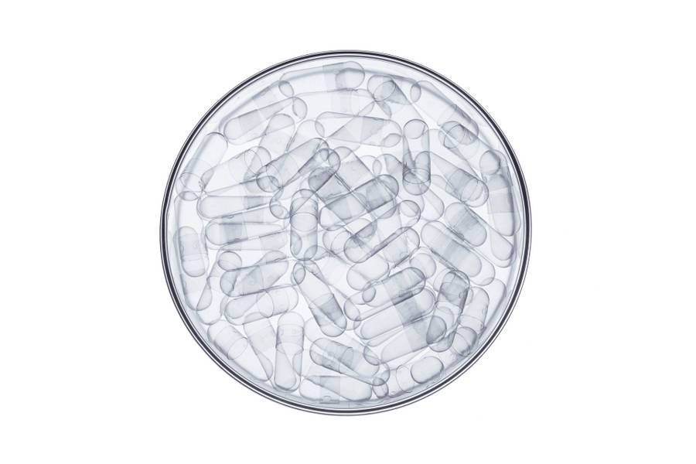
QUORUM INNOVATIONS
Biological Barrier Technology:
A Breakthrough Disease Treatment Paradigm

Slide 2

Agenda
Introduction
Primary goals
Use of funds
Timeline
INVESTOR OFFERING
Summary

Slide 3
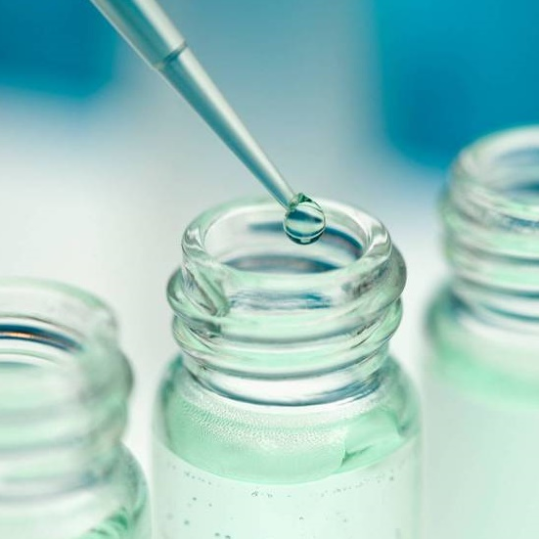
Introduction
Quorum Innovations (QI) develops human body barrier-protective technologies inspired by the human microbiome. Novel QI biological barrier protectants treat damaged tissues affected by microbial imbalance – an unmet need affecting millions of people today.
This simple yet elegant approach revolutionizes the treatment of inflammatory tissue barrier diseases while meeting the market needs of consumers and prescribers alike.
Welcome to The Quorum.

Slide 4

Biological Barrier PlatformTM
The Biological Barrier Platform^{tm} harnesses quorum sensing bacteria to form protective, self-assembling, physical barriers that disrupt biofilms and pathogens.
These barriers collaborate with the body's microbiome to bolster protection against pathogens and stressors, aiding in disease prevention, treatment, and cure.

Slide 5

Primary goal:
MOVE QI BARRIER TECHNOLOGY TO THE CLINIC
PRE-CLINICAL TO CLINICAL vision

Slide 6

First indication:
Bacterial vaginosis (BV)
US
Qi novel bv therapeutic:
Marketing studies indicate prescribers and patients are looking for a new, non-antibiotic treatment
Minimal side effects vs antibiotics (yeast infections)
Works better against recurrence (no antibiotic resistance)
US MARKET:
45 Million WOMEN/YEAR HAVE BV
17 million NEW DIAGNOSES/YEAR
58% RECURRENCE RATE IN 1 YEAR WITH ANTIBIOTIC STANDARD OF CARE

Slide 7

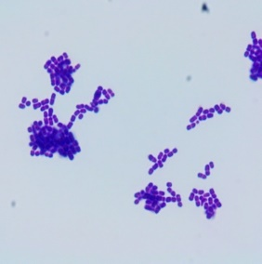
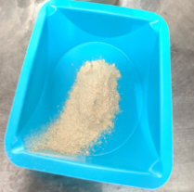
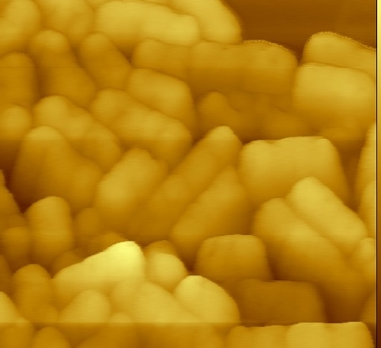
Qi601: a novel postbiotic micromaterial for medical device use
Qi601: protects the human body against colonization by biofilm pathogens
Forms a protective shield on body surfaces
Novel mechanism of action
Not an antibiotic
Platform technology
Qi601: freeze-dried powder (Bottom left); gram stain showing typical lactobacillus (top center); atomic force microscopy of freeze-dried powder showing inactivated (dead) lactobacillus (Bottom Right).

Slide 8
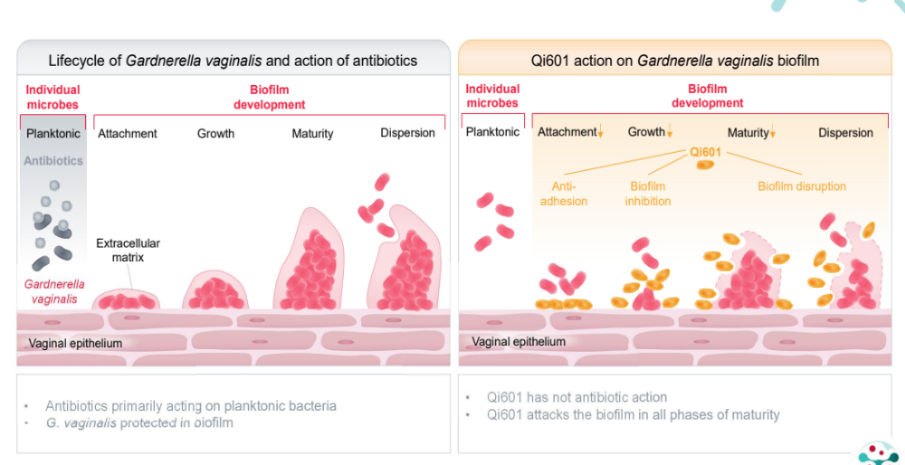
THE PROBLEM: CURRENT TREATMENTS are ineffective
Symptoms recur in 1 year in ~60% of women treated with antibiotic standard of care. Surveys show patient and prescriber want and need innovative treatments that work. BV occurs because of vaginal colonization by Gardnerella biofilms, which antibiotics do not address.
THE SOLUTION:
POSTBIOTIC Qi601 –
qi BARRIER TECHNOLOGY
Qi601-mediated tissue barrier protection targets biofilm:
Qi601 adheres to vaginal wall, protecting it against BV pathogens
Qi601 disrupts BV Gardnerella biofilm on the vaginal surface
Biofilm is then sloughed off and expelled naturally by the body
Qi601 supplements lactobacillus deficiency in peri- and post-menopausal vaginal atrophy (genitourinary syndrome)

Slide 9
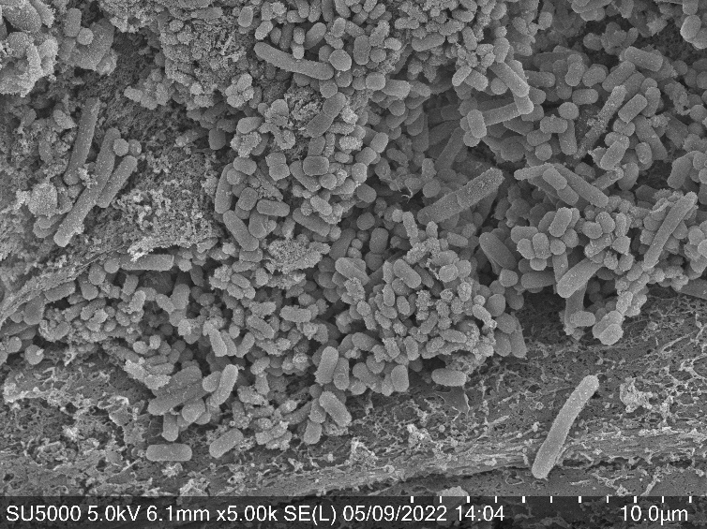
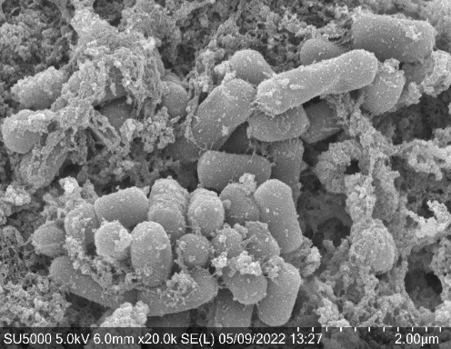
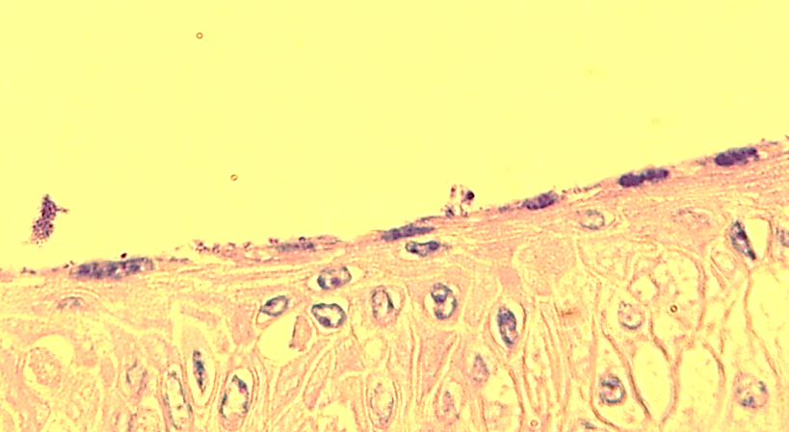
BV BARRIER THERAPEUTIC: QI601
G. vaginalis + Qi601
Figures (left to right): Qi601 rapidly forms a physical protective barrier on human vaginal tissues, defending them from BV biofilm. Scanning electron microscopy (left and middle) shows Qi601 clusters sticking to vaginal cell surfaces in 30 minutes after addition to tissues. The Qi601 (white ovals) interferes with BV pathogen G. vaginalis (black oval) adhesion, detaching >90% of pathogen 30 minutes after treatment of tissues with Qi601. Light microscopy (right slide) shows dark purple areas of Qi601, which prevents and detaches G. vaginalis biofilms at the vaginal tissue surface. Qi601 also adheres directly to the vaginal surface, forming a protective barrier (star, top left).

Slide 10
Quorum intellectual property
25 issued patents
Patent Number | Summary of 4 BV-Specific Patents | Expiration
U.S. Patent No. 9,717,765 | A method for preparing a biologically-active composition, wherein the biological activity is anti-microbial activity or anti-inflammatory activity and is appropriate for topical administration. | 2031
U.S. Patent No. 9,717,769 | A method for identifying and selecting a biologically-active fraction of biofilm cellular mass that is found to have anti-microbial activity or anti-inflammatory activity. | 2031
U.S. Patent No. 10,617,726 | A composition of matter comprising Lactobacillus fermentum Qi6 having Accession No. PTA-122195, grown as a biofilm, and a carrier. | 2036
U.S. Patent No. 11,457,633 | A method for enhancing a barrier against microbial contamination of a surface, wherein said method comprises applying to the surface a composition comprising inactivated Lactobacillus spp. that had been grown as biofilm. | 2040
Flora
Berggren
Chief Executive Officer
Chief Operations Officer
VP Marketing
VP Product
SEO Strategist
Product Designer
Content Developer

Slide 11

bv product launch in 2028: plan
Regulatory strategy
formulation
Manufacturing & scalability
Medical device standard testing
Clinical trials: safety & efficacy
Medical Device:
De-Novo Application
Breakthrough Designation
Pre-Submission mid-2024
Initial formulations will be produced and tested in-house then outsourced to CMO
Quorum is already aligned with Bacthera, a global CMO specializing in biologic manufacturing
Include shelf-life, package, shipping testing and performance testing (sterility, mouse vaginal irritation testing, human patch testing)
Remotely-conducted clinical trials could be done prior to FDA clearance under Medical Device IDE Non-significant Risk category §812.2 (b)

Slide 12
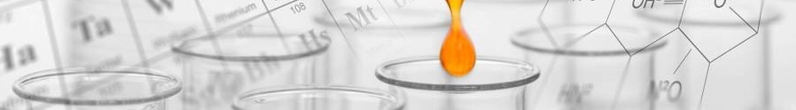
Qi 601 Timeline
v
v
Q3 2024
Q4 2024
Q4 2025
Q4 2026
Q1 2027
Q1 2028
Submit FDA 510(k) Pre-Submission meeting request regarding medical device application
Begin IRB-approved safety/tolerability clinical trial; to be completed in Q3 2025
Begin IRB-approved efficacy clinical trial to be completed in Q3 2026
Complete medical device testing (shipping, packaging, sterility, sealing, in vitro safety)
Submit 510(k) application; assume 180 days for written FDA feedback and additional 180 days bilateral communication
Anticipated approval of Qi601 BV medical device treatment

Slide 13
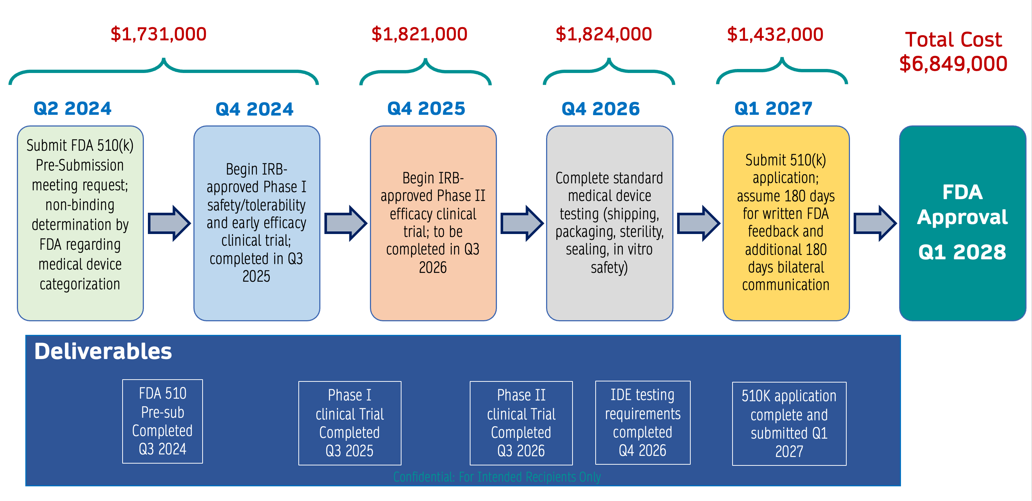
Qi 601 Timeline

Slide 14


QI601 bv US revenue forecast
3 case assumptions
Base Case: launch 2028, women ages 14-69, Qi601 peak share =15% of treated cases and only 3.5% of women infected
Upside: launch 2027, women ages 14-89, Qi601 peak share = 20%
NPV $746 M
Downside: launch 2029, women ages 14-69, Qi601 peak share = 10%
NPV calculated with a 12% discount rate through the forecast period
Investor value creation
Negotiating out-license for non-USA rights to Pharma partner
Out-license Qi601 commercial rights (FDA approval Q1 2028) to US Pharma partner for up-front and milestone payments as well as double-digit royalty payments on sales
Pipeline also includes anti-biofilm burn/wound medical device (DoD use), and additional indications for Qi601 medical device, such as post-menopausal genitourinary syndrome, UTI and vaginal candidiasis

Slide 15
Pipeline: QI platform technology
Medical device product stages
Indication | Preclinical | FDA Pre-Submission for 510(k)/De Novo Pathway | IDE: Safety | IDE: Efficacy | FDA Clearance: De Novo/510(k)
Bacterial Vaginosis (Qi601)
Wound Care (Qi611)
Genitourinary Symptoms of Menopause (Qi601)
Eosinophilic Esophagitis (orphan disease) (Qi601)
Vaginal Candidiasis (Qi601)
Atopic Dermatitis (Qi601)
2024 2025 Anticipated 2028
Not required for 510K Anticipated 2026
2025 2026 Anticipated 2029
TBD
TBD
TBD

Slide 16
Qi 601 second indication: genitourinary syndrome of menopause
US
Qi novel bv therapeutic:
Marketing studies indicate prescribers and patients are looking for a new, non-hormonal treatment
No hormonal side effects (increased cancer risk)
Non-invasive (vs laser treatment), non-hormonal, non-chemotherapeutic
US MARKET:
Affects 30-75% of post-menopausal women, or about 90 million women in the us
This population is going to double between 2020-2050
Significant overlap with bv concurrence and clinical trials,

Slide 17
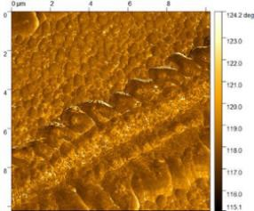
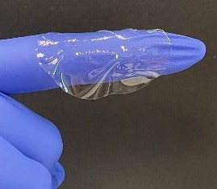
Qi 611 Novel Self Assembling anti-biofilm wound medical device
US
Qi novel self assemblikng anti-biofilm matrix:
Unmet Medical Need – improved infection prevention in complex penetrating traumatic wounds.
There are currently no FDA-approved products to prevent wound biofilms, which are highly prevalent in combat penetrating injuries.
Us market
Dod grant Development underway for the dod with stockpiling
The QI Wound Matrix would compete in the advanced wound care products market, currently a $7 billion annual market in the U.S, and could command a price comparable to other advanced wound care products. These are high-cost treatments, ranging from $2,000 - $6,000/sheet (wholesale) for 1.5 x 1.5 cm to 5 x 5 cm sheets.

Slide 18



Quorum innovations: collaborations
Partners | Lead Programs | Status | Grant
 | Personal Protective Barrier (PPB) Program Novel Ophthalmic Therapeutic | Initiated Feb 2020 Task: develop a novel protein for biologic & chemical protection for the war fighter and first responder. Transitioning to DoD partner below | $1 Million
 | Tough Self Decontaminating Surfaces Broad Spectrum Nasal Anti-Viral (antigen agnostic) | Initiated September 2020 Barrier protection Transitioning to BARDA below | $1 Million
 | July 2020 Entered Joint Development Agreement with Pharma Partner Women’s Health BV | Successfully Concluded JDA diligence 2023 MOA Proof of Concept, Manufacturing, IP Currently in License Discussions | Confidential
 | Barrier Protection and Wound Healing | Award Date – TBD Application in process | Anticipate $3 million
Top 20 Global
Pharma Company

Slide 19
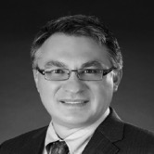
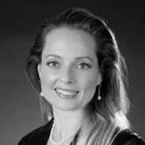
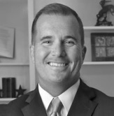
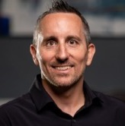
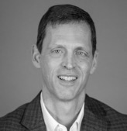
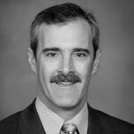
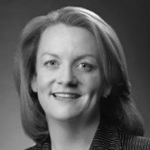
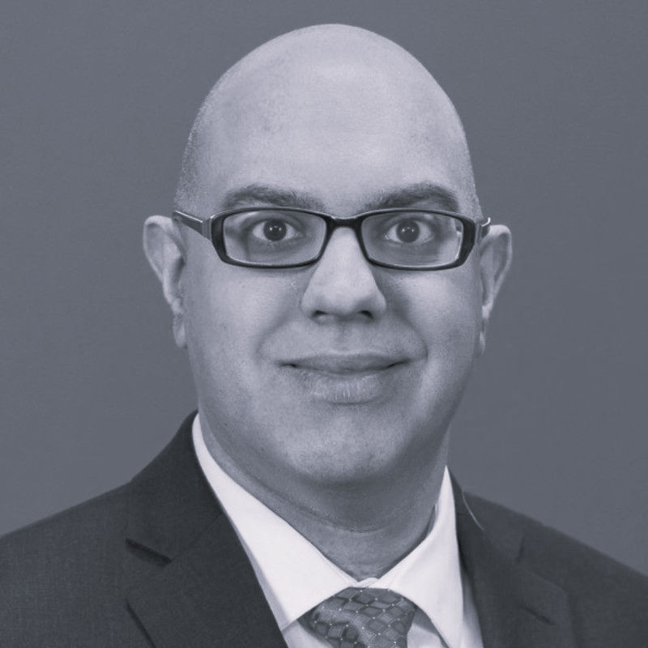
Quorum Team
Nicholas T. Monsul, M.D., FACS
Chief Executive Officer / Founder
Oculofacial and anterior skull-base surgeon
Drexel University (BS & MD)
Yale University School Medicine, Residency
The Johns Hopkins Hospital, Wilmer Institute (Fellowships and Assistant Professor)
Eva Berkes, M.D.
Chief Scientific Officer / Founder
Specialist in Allergy, Asthma and Immunology
Scripps Clinic (Immunology Fellowship)
Clinical Professor, FSU Medical School
Williams College (BA), Univ. of Florida (MD)
Univ. of Florida, Scripps Research Institute
Jim Self
Chief Business Officer / Founder
30+ years pharma / business development
Former Global Leader of BusDev, Merck & Co,
Various BD and Operational roles
MBA Wharton, University of Pennsylvania
Founder ProBioPharm
Chris Gardner
Director, Research & Development
14 yrs Clinical Research & Project Management
BS, Microbiology, Univ. of Florida
20+ Publications in Peer-Reviewed Journals
10+ yrs Sr. Biological Scientist, Univ. of Florida
Multidisciplinary Background in Microbiology, Molecular Biology, Biochemistry and Genetics
David Whitwell, CPA, MBA
CFO/ Advisor
30+ years Finance & Accounting
Founder, Whitwell CFO, LLC
Partner, B2B CFO Partners, LLC
CFO for IWT and Clean Diesel
Finance, Schering Plough (Merck)
David Salinwanchik
Patent Attorney/ Advisor
Salinwanchik, Lloyd & Eisenschenk
Adjunct Prof, Univ of Florida Law School
Juris Doctor, Univ. of Michigan
BS, Chemistry, Univ of Florida
BS, Environmental Science, Univ of Florida
Katie MacFarlane, PharmD
Market Expert / Advisor
Managing Partner, SmartPharma
CCO, Agile Therapeutics
VP Marketing, Warner-Chilcott
Regional Sales Dir., Pfizer
Marketing, Parke-Davis
Ankur Ghandi
Regulatory / Product Development
Founder, SKG RegenMed Consulting
18 years, Regulatory & Product Development
VP Americord; Director,Integry LifeSciences,
Cross-functional expertise/product realization
PhD, Biomedical Engineering (NJIT/UMDNJ)

Slide 20

Investor offering option1
QI is seeking $1.8 M to complete first in human clinical trial FDA cleared Qi601 BV therapeutic medical device.
Quorum is looking for investors to help commercialize a new generation of tissue barrier medical device therapeutics.
Legal Disclaimer: This content is for illustrative purposes only and should not be considered as professional advice. It represents hypothetical scenarios and does not guarantee actual results. Investment involves risks, including the potential loss of capital. Past performance is not indicative of future returns. Always seek advice from qualified professionals for decisions regarding investments or financial strategies.

Slide 21
Investor offering option 2
QI is seeking $7M to achieve FDA cleared Qi601 BV therapeutic medical device.
Quorum is looking for investors to help commercialize a new generation of tissue barrier medical device therapeutics.
Legal Disclaimer: This content is for illustrative purposes only and should not be considered as professional advice. It represents hypothetical scenarios and does not guarantee actual results. Investment involves risks, including the potential loss of capital. Past performance is not indicative of future returns. Always seek advice from qualified professionals for decisions regarding investments or financial strategies.

Slide 22

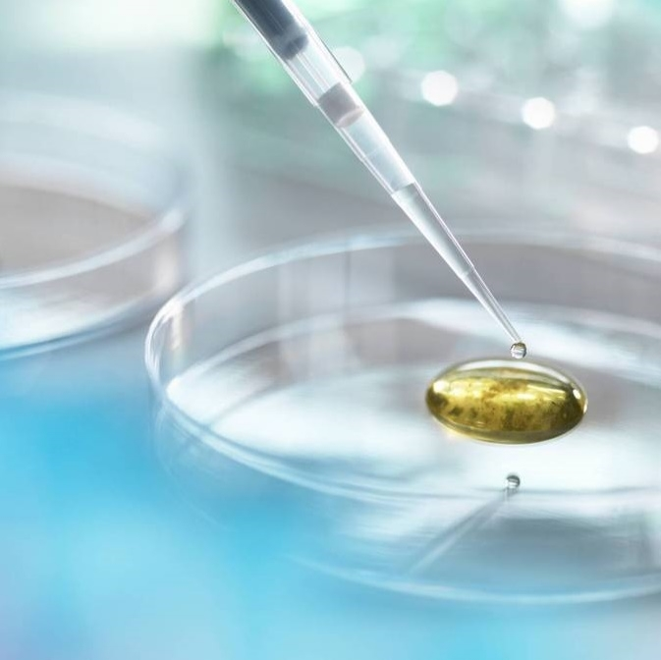
Thank you
Eva Berkes, MD, CSO & Nicholas T. Monsul, MD, CEO​
evaberkesmd@quoruminnovations.com | www.quoruminnovations.com
nickmonsulmd@quoruminnovations.com

